Slide 1
STAT 50 Section 6.3 Tests for a Population Proportion
05/06/2021

Slide 2































Slide 3















Slide 4















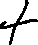

Slide 5
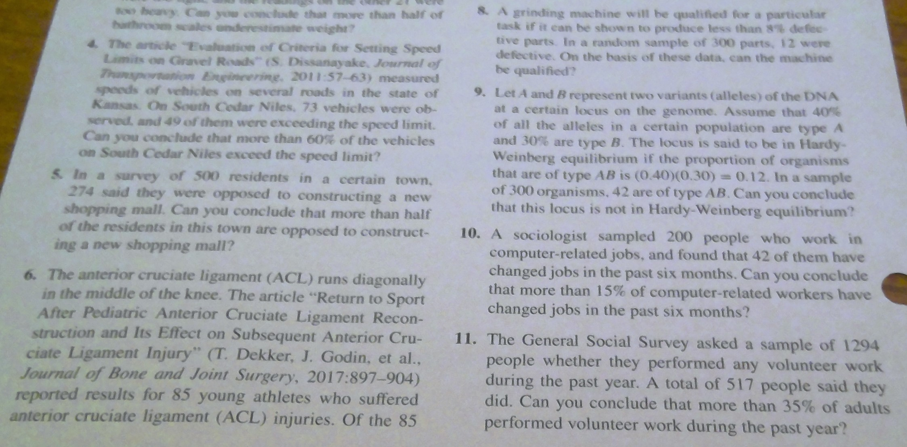

Slide 6
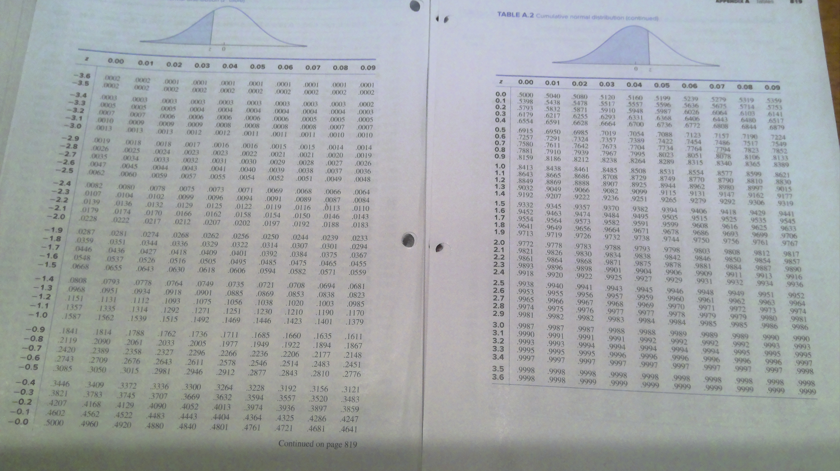

Slide 7






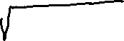


Slide 8

























Slide 9










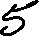




Slide 10









